Slide 1
PREDICTING USED CAR SALES
Team: Used cars analyzers
December 15, 2018

Slide 2
HYPOTHESIS
In addition to vehicle attributes such as year, make, model, and mileage, a used vehicle’s listing price is impacted by local market conditions such as geographic locality and local economic wealth.
Reference:
Carrns, Ann (2013, February 18). Used Car Prices Vary by Market, Analysis Finds. Retrieved from https://bucks.blogs.nytimes.com/2013/02/18/used-car-prices-vary-by-market-analysis-finds/
CarGurus analysis of 3 million car listings in large metropolitan areas
Notes:
Purchasing a used vehicle can be a daunting prospect to any potential buyer.
Beyond having preferences for a particular make, model, and car color, a buyer must assess and weigh other features when researching purchase options. These additional features are often traits related specifically to a vehicle (e.g., vehicles’ year, mileage, etc.), but are there outside factors – such as the geographic market in which the car is sold, or perhaps local economic conditions related to wealth and income – that may help drive a vehicle’s listing price?
A 2013 analysis of vehicles listed on CarGurus.com found that “less-expensive markets tend to be the most heavily populated urban areas, where there are more car dealerships and thus more competition.”
The aim of our project is to blend used vehicle listings data with geographic and income data to identify variables that can help predict a used vehicle’s listing price. We also set out to determine whether a significant difference can be found between vehicle listings in metropolitan (e.g., heavily populated urban areas) and non-metropolitan localities.
https://bucks.blogs.nytimes.com/2013/02/18/used-car-prices-vary-by-market-analysis-finds

Slide 3

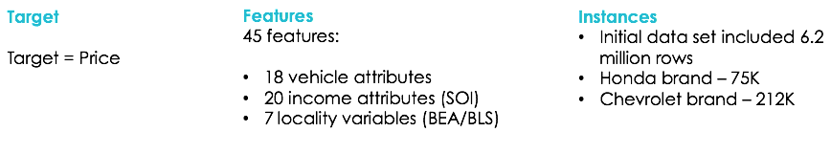
THE DATA

Slide 4
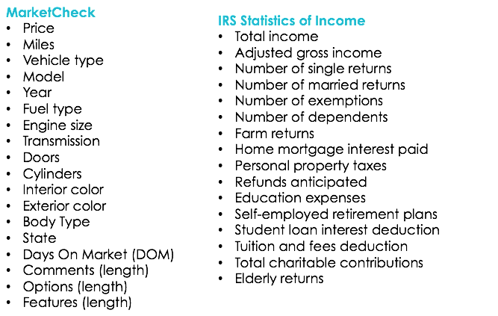
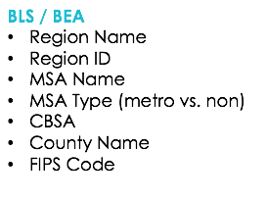
FEATURES

Slide 5
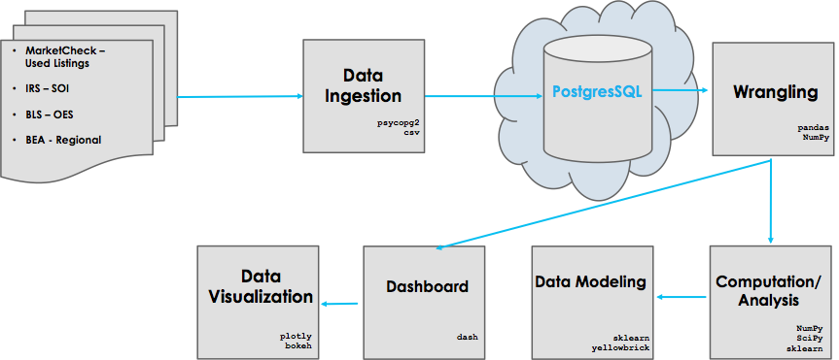
THE PIPELINE

Slide 6
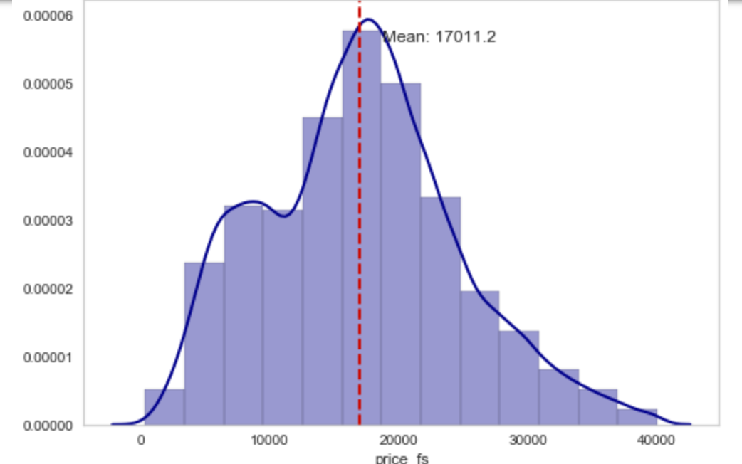
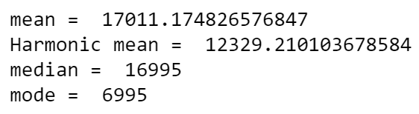
DISTRIBUTION
of Honda dataset
Distribution is approximately normal

Slide 7
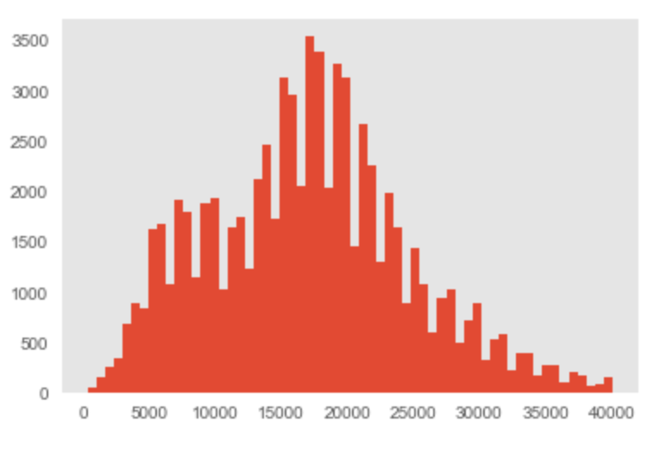
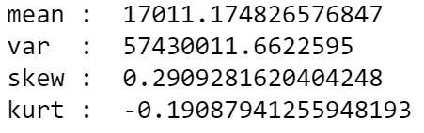
SKEWNESS, KURTOSIS
of Honda dataset
Skewness within range (0.29) – fairly symmetrical
Kurtosis (-0.19) – light tails

Slide 8
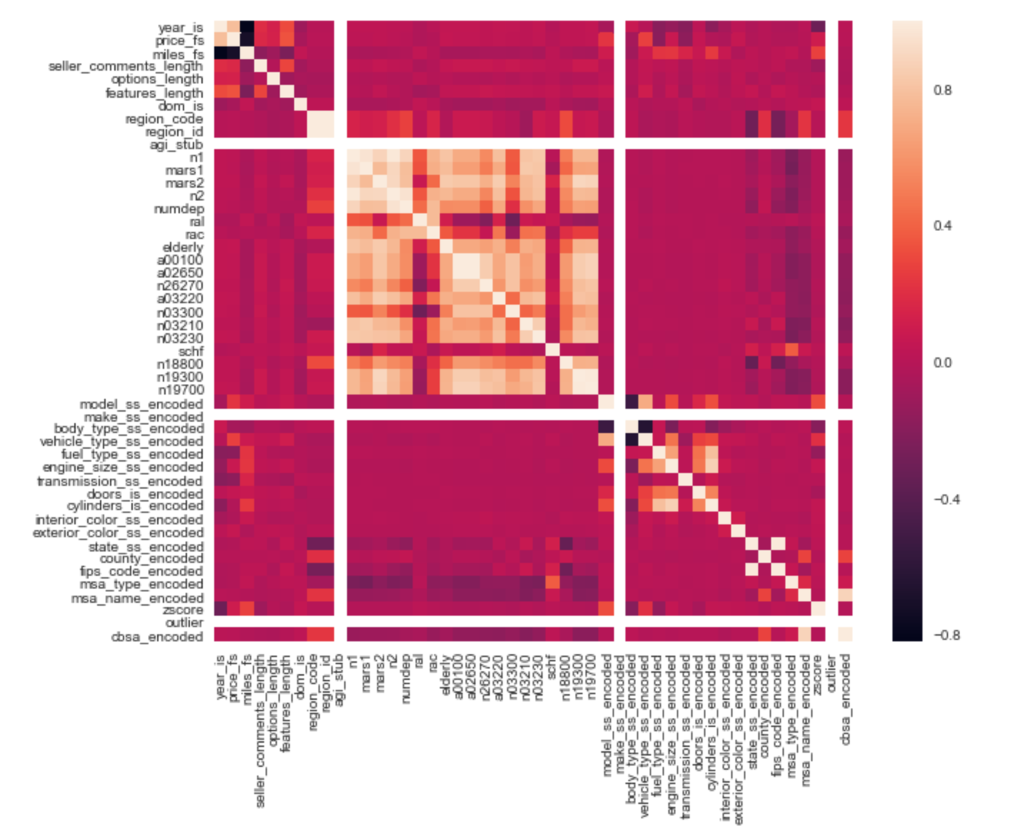
CORRELATION MATRIX
Honda dataset
Year of vehicle is most correlated with price.
Other car features correlated to price include:
Features length
Vehicle type
Model

Slide 9
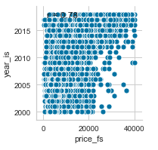
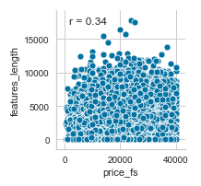
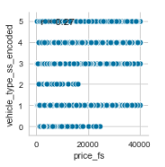
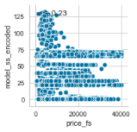
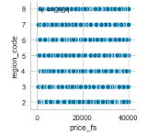
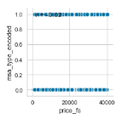
CORRELATION
Honda dataset
Correlation
r = 0.78
r = 0.34
r = 0.27
r = 0.23
No Correlation
r = 0.01
r = -0.02

Slide 10
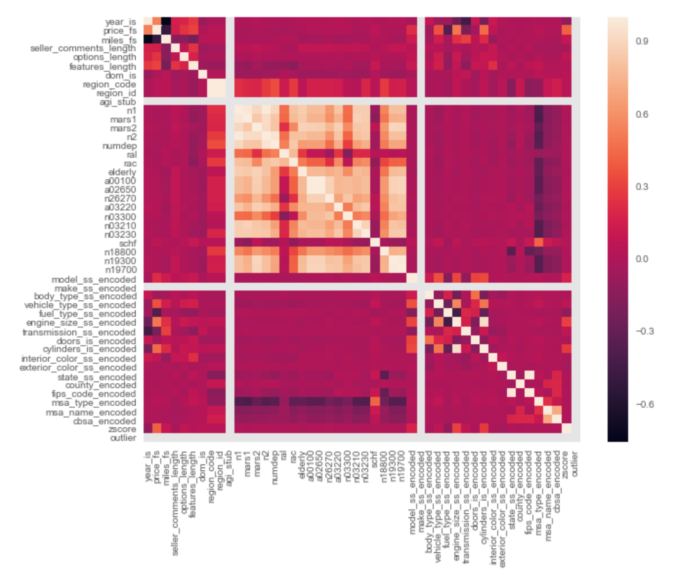
CORRELATION MATRIX
Chevrolet dataset
Similar results as Honda
Year of vehicle correlated with price.
Vehicle type
Other car features correlated to price include:
Engine size
Cylinders

Slide 11
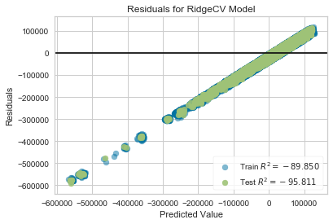
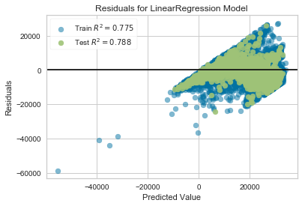
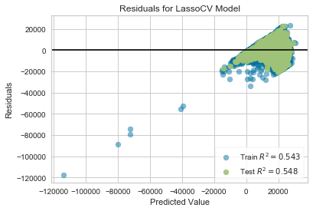
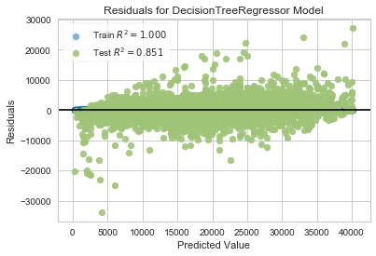
INITIAL MODEL COMPARISON
Notes:
Most clearly, there was an issue with the Ridge model.
It had trouble estimating the price of cars on both the high and low end of the prices.
This resulted in a model with negative r² values and no predictive powers.
The Linear and Lasso models both suffered from some heteroscedasticity problems.
This is shown as there were more error in the higher priced cars.
This is due to our underlying data, as there were relatively few “high priced” used Hondas, so the models had a difficult time learning how to predict them.
The decision tree did not have any of these problems

Slide 12
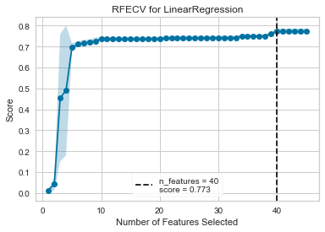
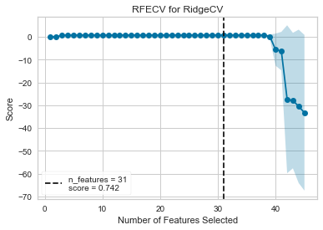
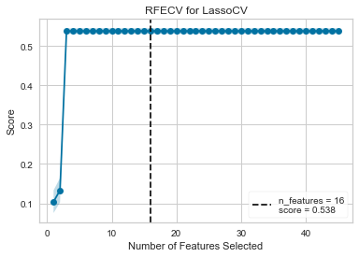
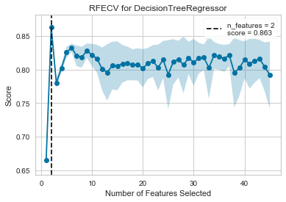
FEATURE SELECTION
Notes:
We first ran a ranked feature to find the ideal number of features for each model
Most notably, decision tree model worked best on only 2 features

Slide 13
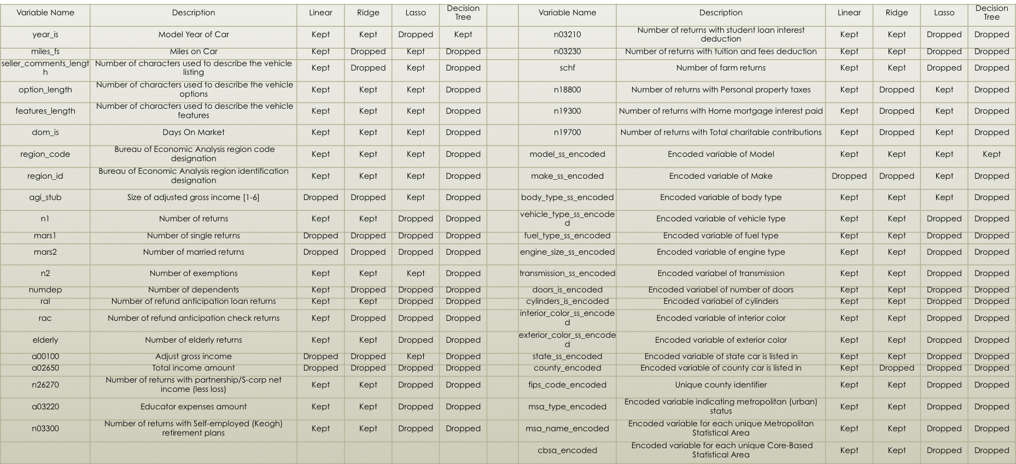
FEATURE SELECTION
Notes:
We ran a recursive feature elimination to find which features to drop.
First, the ranked feature suggested we eliminate at least some features for each model.
Second, each model had different features that were recommended to be eliminated.
While feature selection recommended that different features be eliminated for each model, there were some things that were consistent across all models.
Our features can be categorized into two different categories: data describing the car or data describing the location the car is sold in.
After feature selection, all models except the decision tree kept some of the features that described the car and the location.
The decision tree model only kept the model year of the car and the make of the car

Slide 14
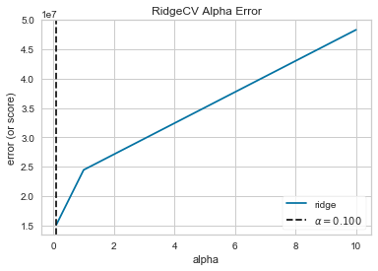
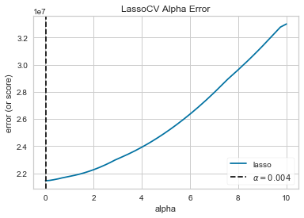
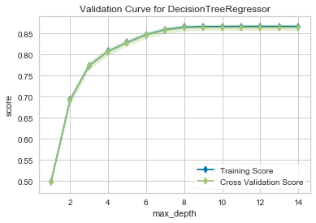
HYPERPARAMETER TUNING
Notes:
For the Lasso and Ridge model, we used the AlphaSelection function and for the Decision Tree model, we used the validation curve to find the ideal depth of the decision tree.
For the Lasso model, we found an ideal alpha of 0.1.
For the Ridge model, we found an ideal alpha of 0.004.
For the Decision Tree model, we found an ideal max depth of 8, as at any deeper, there stopped being a distinguishable increase after 8 and any more would leave us at a risk of overfitting.

Slide 15

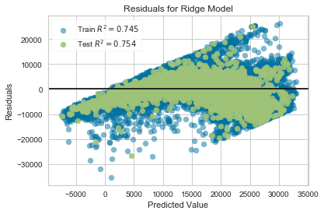
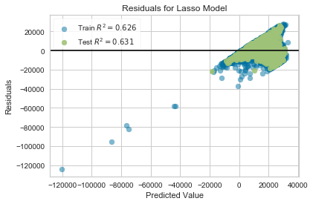
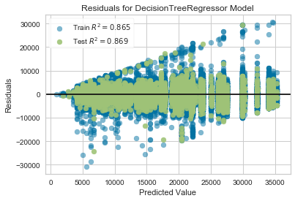
FINAL MODELS
Notes:
The Lasso model performed the least well, which is due to the issues we found earlier in predicting the price of the highest and lowest price models.
Given the success of the Linear and Ridge models, which use both location and car based features, we are able to conclude that both the features of a used car and the location it is sold in have an effect on the price the car is sold for.
However, the Decision Tree model was the most successful model, which points out that the year and the model of the used car are clearly the most significant determinants of the price.

Slide 16
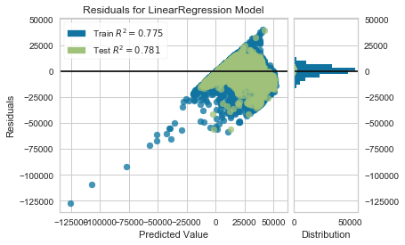
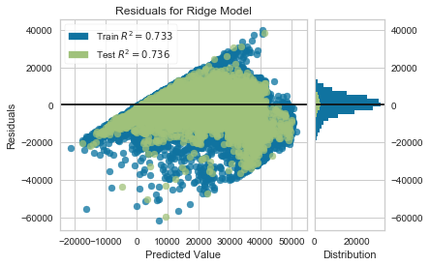
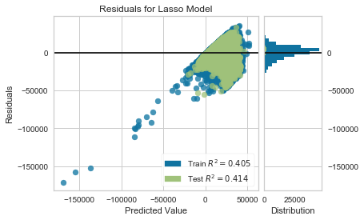
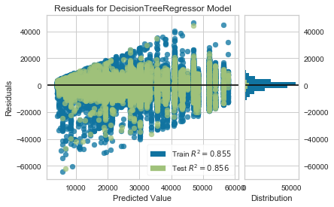
MODEL VALIDATION WITH USED CHEVROLETS

Slide 17
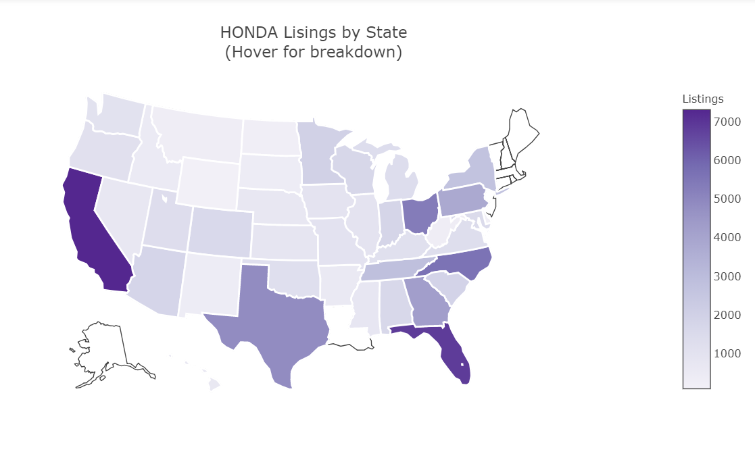

Slide 18
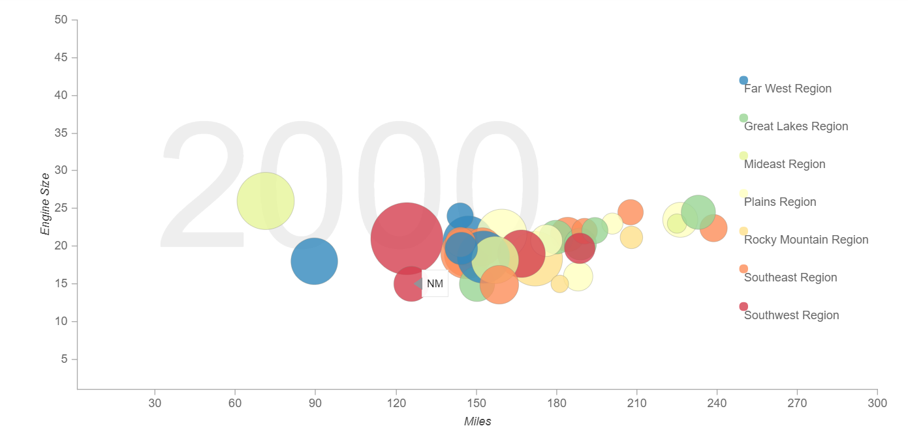
Honda - Price – Engine Size – Miles - Region

Slide 19
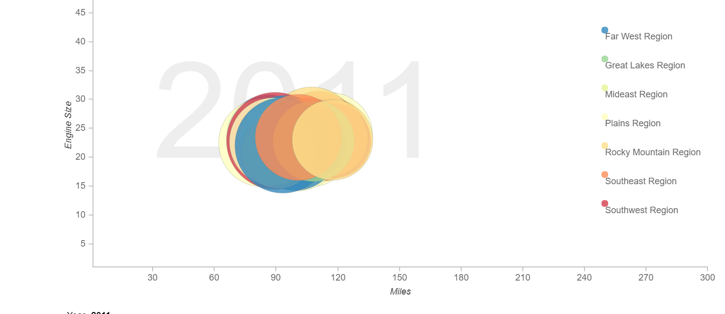
Honda - Price – Engine Size – Miles - Region

Slide 20
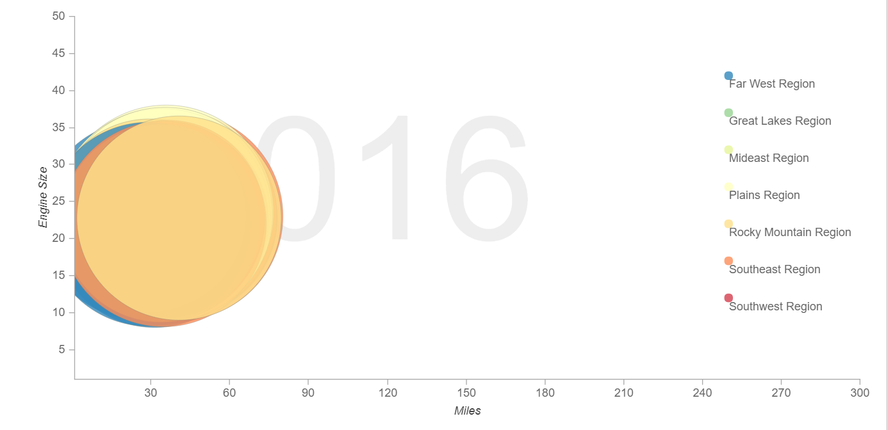
Honda - Price – Engine Size – Miles - Region

Slide 21
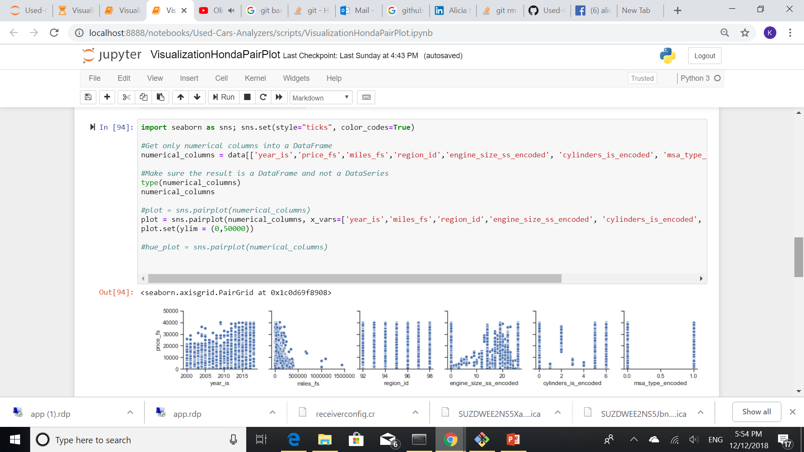
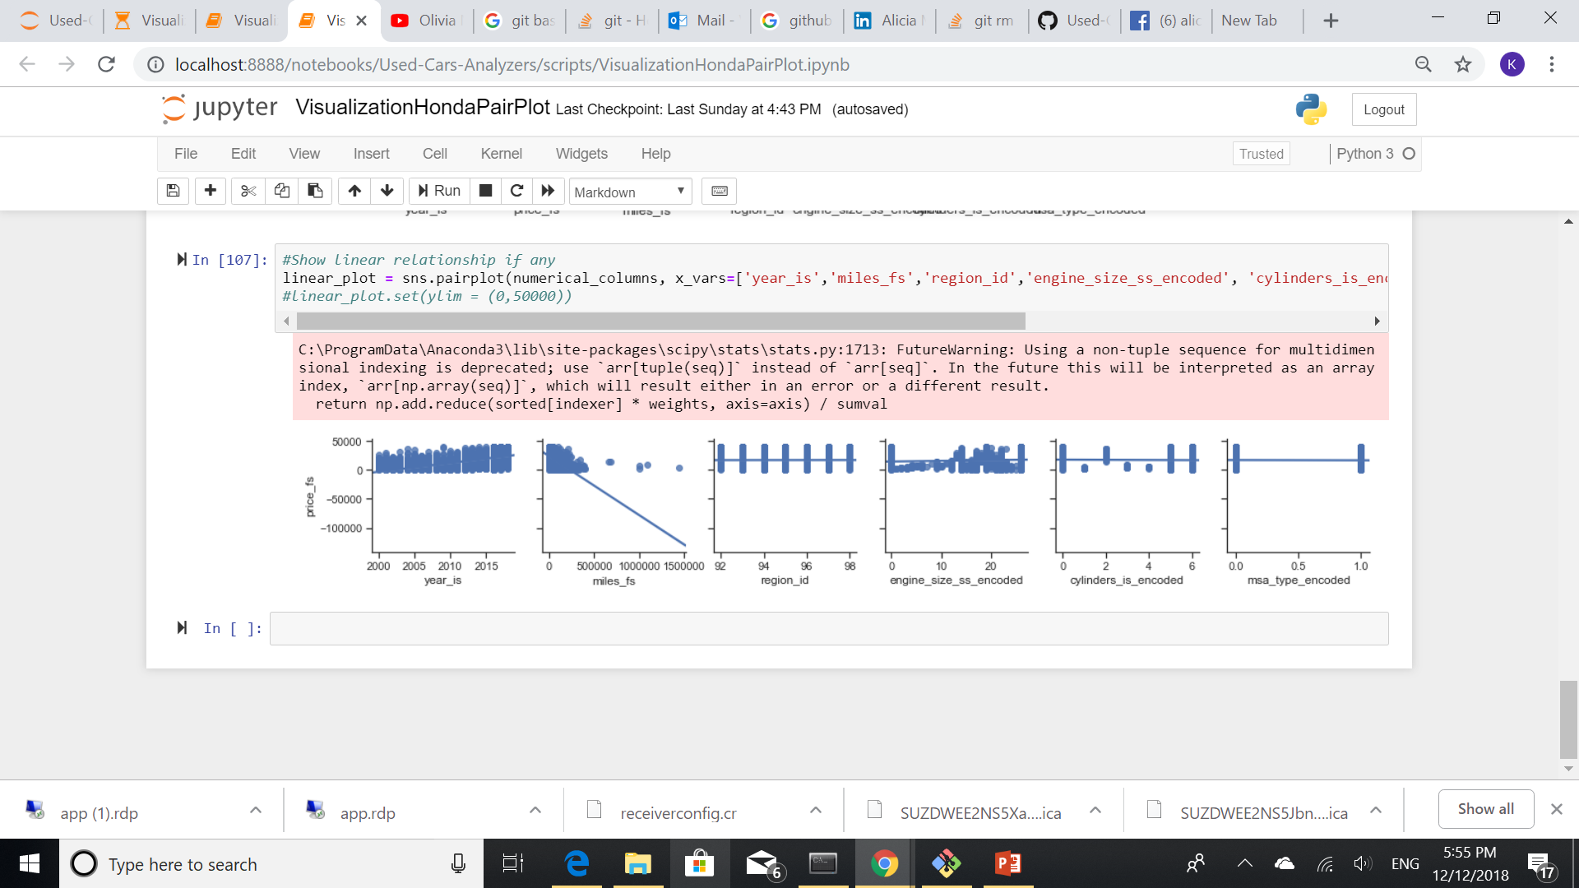
PAIRPLOT
Joint Plot
Linear Relationship

Slide 22
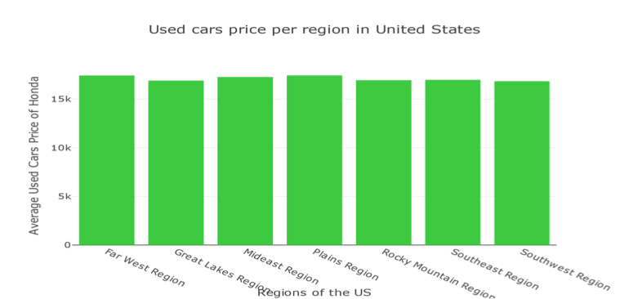
Car Analyzer Dashboard
Notes:
When compared across the US, used cars price was almost the same for each model.
After all the numbers was crushed and we after we try various models and feature tuning, no one region saw a significant change in price for each used vehicle model

Slide 23
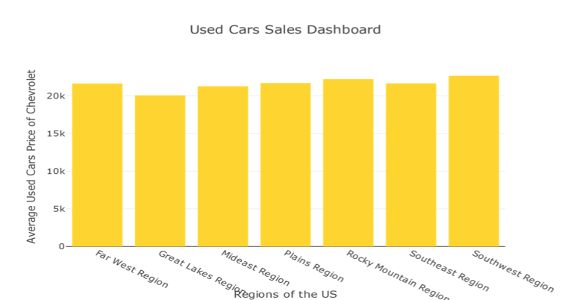
Car Analyzer Dashboard
Notes:
The codes were ran on another vehicle model (Chevrolet), and the number did not changed

Slide 24
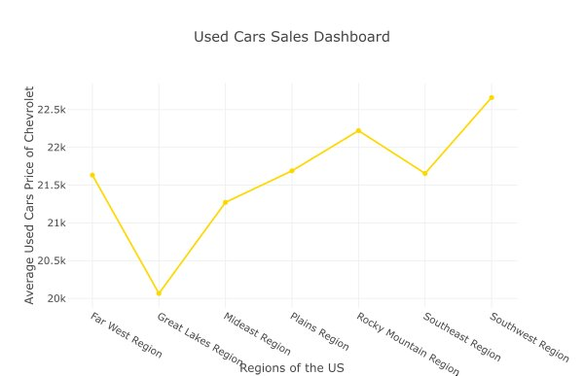
Car Analyzer Dashboard

Slide 25
MSA Comparison
Model | Metropolitan Median Price | Non-Metropolitan Median Price | More Expensive Market | $ Difference | % Difference
CR-V | $18,250 | $17,999 | Metropolitan | $251 | 1.38
CIVIC | $14,991 | $14,712 | Metropolitan | $280 | 1.88
ACCORD | $16,950 | $15,774 | Metropolitan | $1,176 | 7.19
ACCORD HYBRID | $22,722 | $24,463 | Non-Metropolitan | $1,741 | 7.38
ODYSSEY | $20,400 | $16,999 | Metropolitan | $3,402 | 18.19
FIT | $12,998 | $13,637 | Non-Metropolitan | $639 | 4.80
RIDGELINE | $22,994 | $22,995 | Non-Metropolitan | $1 | 0.00
PILOT | $24,372 | $22,900 | Metropolitan | $1,472 | 6.23
Notes:
On average, you won't see much of a difference (as either a monetary amount or percentage) between a vehicle sold in a Metropolitan versus a non-Metropolitan market. With our dataset, the Honda Odyssey (a minivan) seems to be an outlier as we do see a significant difference.
Also of interest, a Honda Accord is about 7% more expensive in a metropolitan market but an Accord Hybrid is 7% more expensive in a non-Metropolitan market.

Slide 26
Conclusions
Next Steps
The most significant features impacting price were the year and model of the car
Income attributes had little to no impact on price
The decision tree was the best performing model. The linear and Ridge models also performed well.
These models took into account many features, including both features that describe the car and features that describe the location of the car
Consider differences in luxury car market, i.e. brands such as Mercedes, BMW, Tesla
Analyze results at the model vs. make level
Consider impact from upgrade features, i.e. moonroof, navigation package, video package, technology package

